Slide 1
Literature Review
Zain Hoda

Slide 2
Question: What are the challenges in the adoption of used EV’s?
Current Status: Overview of the issues in the current Market (New EV’s)

Slide 3
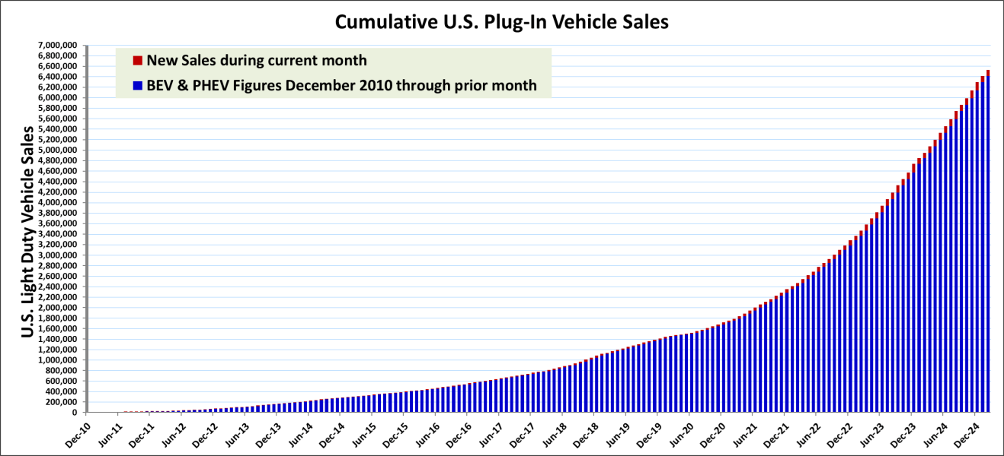
Growth of EV market

Slide 4
Demand Side Issues
Consumer Preferences
Range anxiety
Long charging times
Lack of access to charging stations
Complexity of charging infrastructure
Negative perception of safety
Concerns about overall lifetime cost of the vehicle

Slide 5
Demand Side Issues
Consumer Characteristics
Socioeconomic status
Lifestyle choices
PEV Usage
Lower “VMT” (Vehicle Miles Travelled)

Slide 6
Demand Side Issues
Contextual Factors
Financial Incentives
Infrastructure
Energy Prices
Consumer Engagement
Disconnect between technical improvements and perceptions

Slide 7
Supply Side Issues
Battery Supply Issues
Materials (Lithium, Cobalt)
Battery Production
Battery end-of-life(EOL) and recycling
EV production
Production Sites
Workforce

Slide 8
Supply Side Issues
EV Charging Infrastructure
Charger Deployment
Other Considerations (Profitability, Relaibility)
Policy Considerations
ZEV Mandates
Emission Standards
Fossil fuel vehicle bans
Incentives and subsidies for manufacturers

